Slide 1

Analysis Of Customer Service Data
Made By :-
Archit Tripathi
ABADS-15

Slide 2
Overview And Key Metrics
Project Overview & Key Metrics
Project Objective:
The goal of this analysis is to use data to make customer service better. By looking at past customer service data, we want to find patterns and areas where we can improve. This will help us provide a better experience for customers, make our business run more smoothly, and help the business grow.
2. Key Metrics:
Customer Name: Total number of unique customers is 32,940 Nos.
CSAT Score: Average customer satisfaction score is 5.60.
Sentiment: General sentiment trend (positive, neutral, negative) based on customer feedback is 13% positive, 33% negative, 27 % neutral, 18 % very negative, 9 % very positive.
Call Duration in Minutes: Average call duration is 25.18mins.

Slide 3
3. Visualizations:

Slide 4
Detailed Insights
Detailed Insights & Analysis
Customer Interactions:
Channel : Distribution of call channels is call center, chatbot, email and web.
Call Reasons:
Reason: Most common reasons for calls is Billing Question.
City: Sentiment by city 2191 customers are negative , 1773 netural, 837 positive, 1173 very negative, 602 very positive.
State : Average CSAT score done by state is 5.55.

Slide 5
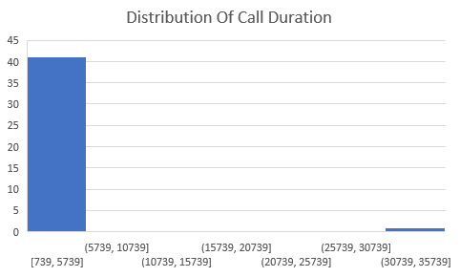
Visualizations:

Slide 6
Actionable Recommendations and Next Steps
Recommendations & Next Steps
Recommendations:
Improvement Areas: Improving CSAT scores and addressing negative sentiment is an ongoing process that requires dedication and adaptability. By thoroughly analyzing feedback, addressing root causes, enhancing customer experience, and continually engaging with customers, we can foster a positive perception and build long-term loyalty.
Resource Allocation: By systematically collecting and analyzing call data, assessing current staffing levels, and understanding the specific needs during peak periods, we can identify areas where improvements are necessary. Recommendations might include adjusting staff schedules, hiring additional temporary personnel, cross-training employees, enhancing technology, or improving self-service options, Implementing these changes thoughtfully can lead to reduced wait times, more efficient call handling, and ultimately higher customer satisfaction.

Slide 7
2. Next Step:
Follow-up Actions: To plan for further analysis or specific actions to address common issues in staffing or resource management based on call data, we can follow a structured approach. This involves identifying issues, analyzing their causes, and implementing targeted solutions.
Additional Data Needs: Any additional data or metrics required for deeper insights is, response times, wait times, and resolution times, call satisfaction scores, first-call resolution rates, and quality assurance ratings to evaluate service effectiveness add average handling time, adherence to schedule, and productivity rates, Feedback from customer surveys, Net Promoter Scores , and customer effort scores to understand their experience and satisfaction levels.
By integrating these additional metrics into your analysis, you can develop a more nuanced understanding of operational challenges and identify targeted strategies for improvement.

Slide 8
Thanks

